Slide 1

“Wind Power for Local Economic Development: South Africa leading the Way”

Slide 2
“SAWEA, tell us what you can do for the country instead of telling us what we can do for you”

Slide 3

Who we are
“SAWEA’s primary purpose is to promote the sustainable use of wind energy in South Africa acting as a central point of contact for information for its members, and as a group promoting wind energy to government, industry, the media and the public.”

Slide 4
What we believe
“Coming together is a beginning;
keeping together is progress;
working together is success.”
Henry Ford

Slide 5
Who we are
100

Slide 6
Who we are
The national wind industry body in SA
NPO
Over 100 members
Mission
“SAWEA’s primary purpose is to promote the sustainable use of wind energy in South Africa acting as a central point of contact for information for its members, and as a group promoting wind energy to government, industry, the media and the public.”

Slide 7
What does local economic development actually mean?

Slide 8
LED Definitions - GTZ
" LED is an ongoing process by which key stakeholders and institutions from all spheres of society, the public and private sector as well as civil society, work jointly to create a unique advantage for the locality and its firms, tackle market failures, remove bureaucratic obstacles for local businesses and strengthen the competitiveness of local firms."

Slide 9
LED Definitions – World Bank
"The purpose of local economic development (LED) is to build up the economic capacity of a local area to improve its economic future and the quality of life for all. It is a process by which public, business and nongovernmental sector partners work collectively to create better conditions for economic growth and employment generation."

Slide 10
LED Definitions - ILO
"Local economic development (LED) is a participatory process which encourages social dialogue and public-private partnerships in a defined geographical area. LED enables local stakeholders to jointly design and implement a development strategy which fully exploits local resources and capacities, and makes best use of the area's comparative advantages."

Slide 11
LED Definitions - UN-Habitat
"Local economic development (LED) is a participatory process where local people from all sectors work together to stimulate local commercial activity, resulting in a resilient and sustainable economy. It is a tool to help create decent jobs and improve the quality of life for everyone, including the poor and marginalized. Local economic development encourages the public, private and civil society sectors to establish partnerships and collaboratively find local solutions to common economic challenges. The LED process seeks to empower local participants in order to effectively utilize business enterprise, labour, capital and other local resources to achieve local priorities (e.g., promote quality jobs, reduce poverty, stabilize the local economy generate municipal taxes to provide better services)."

Slide 12

SAWEA Recipe for LED Mala Mogodu

Slide 13
Key ingredients for our Mogodu
market failures
bureaucratic obstacles
competitiveness of local firms
public, business and nongovernmental sector partners
local stakeholders,
local commercial activity,business enterprise, labour, capital and other local resources

Slide 14
Cooking instruction for our Mogodu
tackle market failures
remove bureaucratic obstacles
strengthen the competitiveness of local firms
public, business and nongovernmental sector partners work collectively
local stakeholders to jointly design and implement a development strategy which fully exploits local resources and capacities,
participatory process where local people from all sectors work together to stimulate local commercial activity,
empower local participants in order to effectively utilize business enterprise, labour, capital and other local resources to achieve local priorities (e.g., promote quality jobs, reduce poverty, stabilize the local economy generate municipal taxes to provide better services)

Slide 15
What we are doing
Tackle market failure & remove bureaucratic obstacles
Comprehensive commentary on all draft papers
REFIT Tariff, Rules, Cost recovery, MYPD, PPA etc
IRP2010
Comprehensive document drafted and submitted to decision maker and key stakeholders formally launched at cocktail function with Deputy DG DOE
Formal submission on parameters
Significant one on one direct lobbying and engagement with ministries

Slide 16

What we are doing
strengthen the competitiveness of local firms
local stakeholders to jointly design and implement a development strategy which fully exploits local resources and capacities,

Slide 17
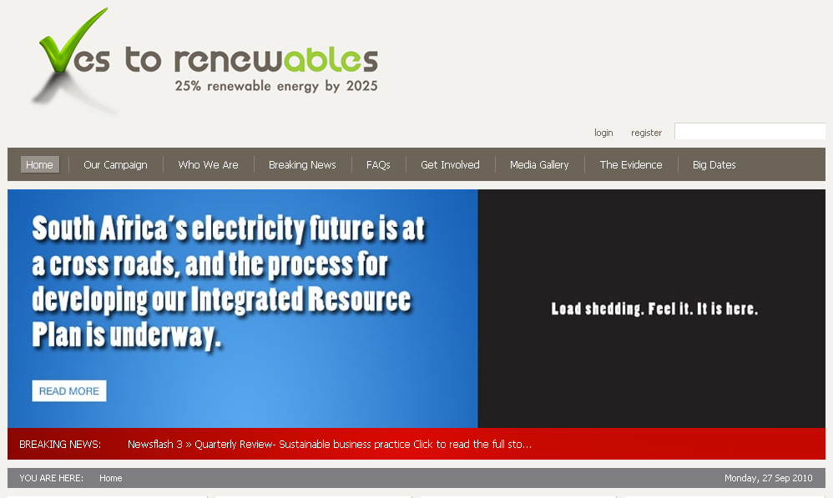

Slide 18
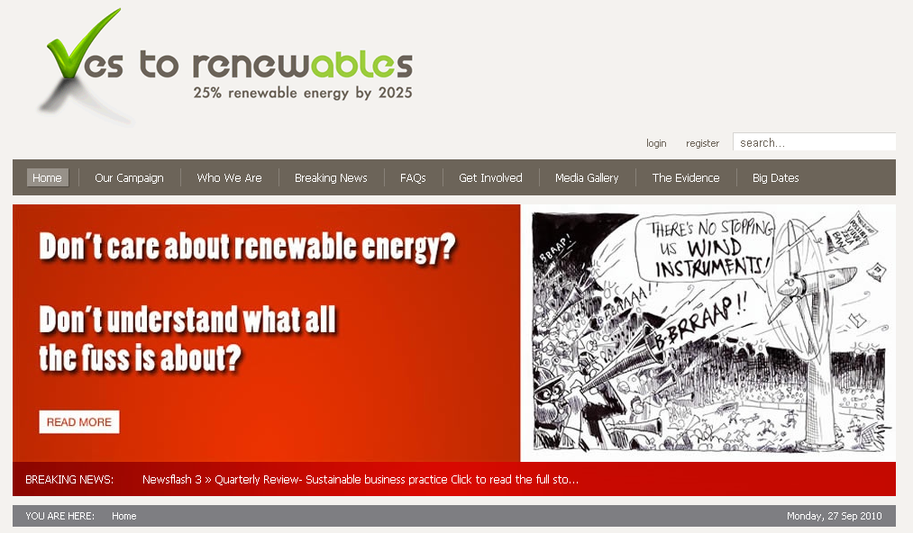

Slide 19
What we are doing
participatory process where local people from all sectors work together to stimulate local commercial activity,
empower local participants in order to effectively utilize business enterprise, labour, capital and other local resources to achieve local priorities (e.g., promote quality jobs, reduce poverty, stabilize the local economy generate municipal taxes to provide better services)

Slide 20
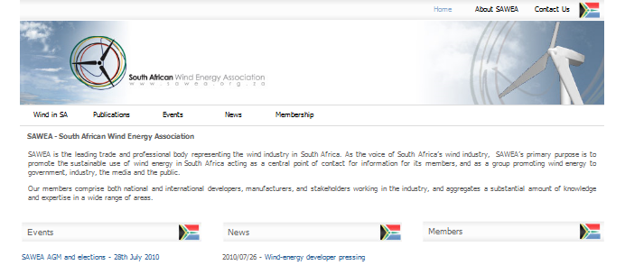
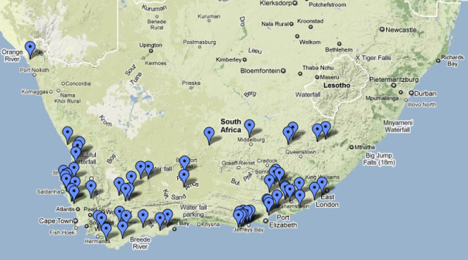
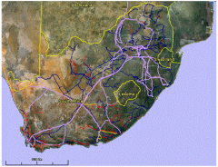
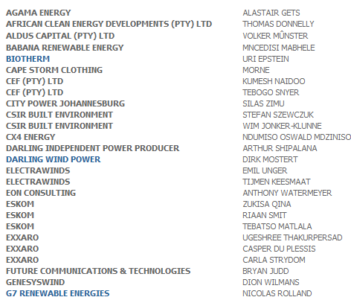
Project informations, member directory, research, studies, presentations…

Slide 21
Dedicated working groups
Policy
Collaborating with the DoE, Eskom, NERSA etc.
Legislation
permitting, EIA, Agricultural, Land Act, PPA
Technical
all technical related matters
Skills development
build up of skills for the industry
Market
rules, fairness, removal of enablers and barriers, grid connection, grid codes
Events
Workshops and events
Windaba 011 Conference and Exhibition taking place at the Cape Town Convention Centre, 27-29 September 2011
Public Relations
industry info and overview

Slide 22
Conclusion
LED = Industry of Scale + supportive legislative framework + Collaborative effort
Industry of scale = 30 000 MW by 2025
Supportive Leg. = Long term REFIT certainty
Collaborative effort = Strong industry body working closely with public, private and community

Slide 23

I WANT YOU
FOR SAWEA

Slide 24

Windaba 2011 Conference and Exhibition Cape Town Convention Centre,
27-29 September 2011
Join SAWEA by visiting www.sawea.org.za or email louise@sawea.org.za

Slide 25
Windaba 2011 Conference and Exhibition Cape Town Convention Centre,
27-29 September 2011
Join SAWEA by visiting www.sawea.org.za or email louise@sawea.org.za

